Slide 1

JavaScript Promise and Promise Chaining
Mr. Mohan Kumar T G
Asst. Professor, Dept. ISE,
NMIT, Bengaluru

Slide 2

JavaScript Promise
In JavaScript, a promise is a good way to handle asynchronous operations.
It is used to find out if the asynchronous operation is successfully completed or not.
A promise may have one of three states.
i. Pending
ii. Fulfilled
iii. Rejected

Slide 3
JavaScript Promise Example
A promise starts in a pending state. That means the process is not complete. If the operation is successful, the process ends in a fulfilled state. And, if an error occurs, the process ends in a rejected state.
For example, when you request data from the server by using a promise, it will be in a pending state. When the data arrives successfully, it will be in a fulfilled state. If an error occurs, then it will be in a rejected state.

Slide 4

Create a Promise
To create a promise object, we use the promise() constructor.
The promise() constructor takes a function as an argument. The function also accepts two functions resolve() and reject().
If the promise returns successfully, the resolve() function is called. And, if an error occurs, the reject() function is called.

Slide 5

Example1
Asynchronous program can be handled by using JavaScript Promise.
In this program, a promise() object is created that takes two functions: resolve() and reject(). resolve() is used if the process is successful and reject() is used when an error occurs in the promise.
The promise is resolved if the value of count is true.

Slide 6
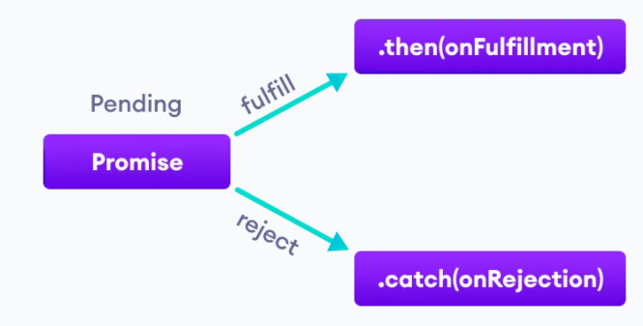
Working of JavaScript Promise

Slide 7
JavaScript Promise Chaining
Promises are useful when you have to handle more than one asynchronous task, one after another. For that, we use promise chaining.
You can perform an operation after a promise is resolved using methods then(), catch() and finally().

Slide 8

JavaScript then() method
The then() method is used with the callback when the promise is successfully fulfilled or resolved.
The syntax of then() method is
In the above program, the then() method is used to chain the functions to the promise. The then() method is called when the promise is resolved successfully.
You can chain multiple then() methods with the promise.

Slide 9

JavaScript catch() method
The catch() method is used with the callback when the promise is rejected or if an error occurs.
In this program, the promise is rejected. And the catch() method is used with a promise to handle the error.

Slide 10
JavaScript Promise Versus Callback
Promises are similar to callback functions in a sense that they both can be used to handle asynchronous tasks.
JavaScript callback functions can also be used to perform synchronous tasks.
Their differences can be summarized in the following points.
JavaScript Promise
The syntax is user-friendly and easy to read.
Error handling is easier to manage.
JavaScript Callback
The syntax is difficult to understand.
Error handling may be hard to manage.

Slide 11
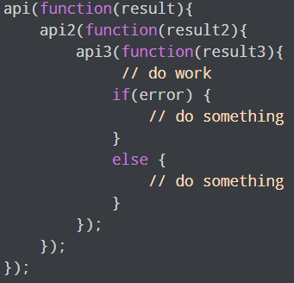
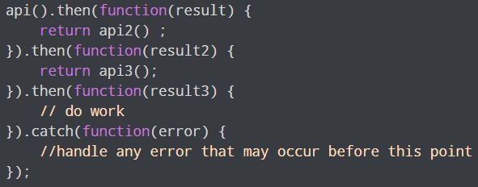
JavaScript Promise Vs. Callback

Slide 12
JavaScript finally() method
The finally() method gets executed when the promise is either resolved successfully or rejected.

Slide 13
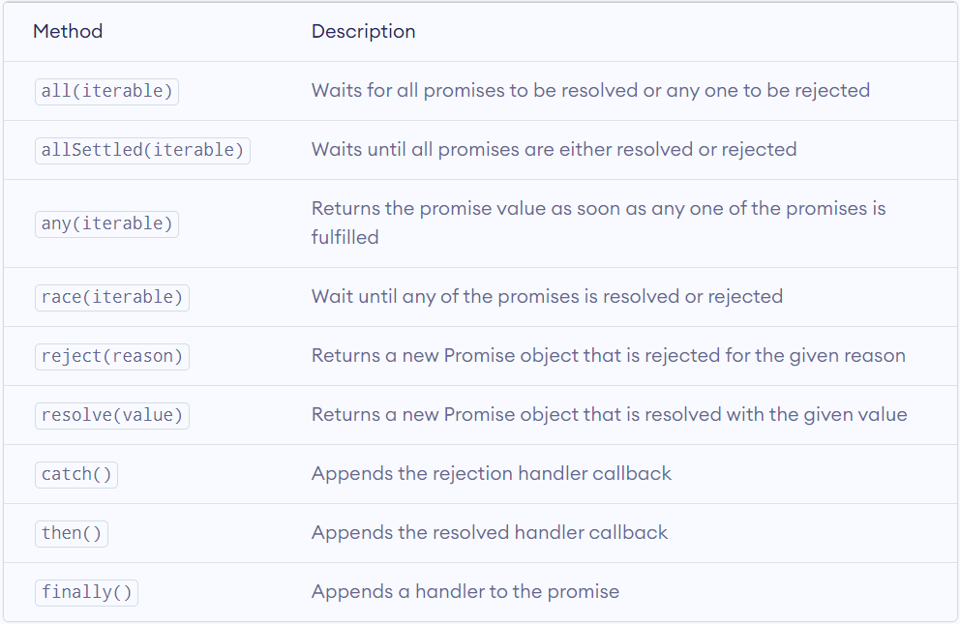
JavaScript Promise Methods

